Slide 1



Housing Price Index vs Household Median Income
By: Wee Kiam, Sophia, Zu and Dawn

Slide 2
Problem Statement
Explore the relation between the household median income and housing price index (Private & HDB)
Anecdotal
Empirical

Slide 3
Stakeholder Analysis
Primary Stakeholders:
Government bodies (to help with policymaking e.g. cooling measures, grants)
Secondary Stakeholders:
General public

Slide 4
Source of Data and Data Type
Quantitative Data Type
Multi-structured/ Hybrid Data Type
Acquisition: Public data available from Singstat and Data.gov.sg
Private Property Price Index: https://data.gov.sg/dataset/private-residential-property-price-index-by-type-of-property
HDB Resale Price Index Data of Median Monthly Income: https://data.gov.sg/dataset/hdb-resale-price-index
Data of Median Monthly Income: https://www.tablebuilder.singstat.gov.sg/publicfacing/createDataTable.action?refId=12307

Slide 5


Slide 6
Observations about the Median Monthly Income over Time
Notice the dip in 2009
From $6100 in Year 2008 to $6006 in Year 2009 – linked to Asian Financial Crisis in 2008, hence impacts show up in 2009

Slide 8
Descriptive Statistics
HDB Price Index
Mean | 108.553571
Standard Error | 6.44037055
Median | 118.6
Mode | #N/A
Standard Deviation | 29.5134856
Sample Variance | 871.04583
Kurtosis | -1.8691931
Skewness | -0.1787612
Range | 78.45
Minimum | 69.525
Maximum | 147.975
Sum | 2279.625
Count | 21
Private Price Index
Mean | 124.814881
Standard Error | 6.95150012
Median | 136.1625
Mode | #N/A
Standard Deviation | 31.8557755
Sample Variance | 1014.79043
Kurtosis | -1.7903927
Skewness | -0.2227433
Range | 81.2625
Minimum | 81.5625
Maximum | 162.825
Sum | 2621.1125
Count | 21
Median Monthly Household Income
Mean | 6746.190476
Standard Error | 410.887197
Median | 6342
Mode | #N/A
Standard Deviation | 1882.921682
Sample Variance | 3545394.062
Kurtosis | -1.693771277
Skewness | 0.135215268
Range | 5027
Minimum | 4398
Maximum | 9425
Sum | 141670
Count | 21

Slide 10
% Change Analysis on a Yearly Basis

Slide 11
Cumulative % Change Analysis

Slide 12
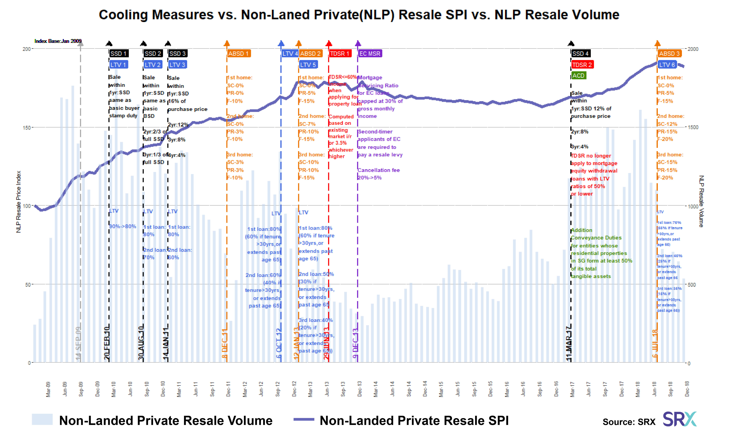
Source: https://www.srx.com.sg/cooling-measures

Slide 13
Insights
Increase and decrease of PI are affected by:
Implementation of Total Debt Servicing Ratio (TDSR)
Additional Buyer and Seller Stamp Duties (ABSD)

Slide 14
Multiple Linear Regression
Chosen because:
Quantitative Data
More than one predictor variable

Slide 15
MLR – Predicting Private PI
Regression Analysis
OVERALL FIT
Multiple R | 0.97898151 |  | AIC | 83.57140887
R Square | 0.9584048 |  | AICc | 86.07140887
Adjusted R Square | 0.95378312 |  | SBC | 86.70497618
Standard Error | 6.8483904
Observations | 21
ANOVA |  |  |  | Alpha | 0.05
 | df | SS | MS | F | p-value | sig
Regression | 2 | 19451.6005 | 9725.80026 | 207.3711454 | 3.7272E-13 | yes
Residual | 18 | 844.208119 | 46.9004511
Total | 20 | 20295.8086
 | coeff | std err | t stat | p-value | lower | upper | vif
Intercept | 9.35828887 | 5.88177758 | 1.59106473 | 0.129004228 | -2.9988673 | 21.715445
Median Monthly Household Income | 0.00242221 | 0.00204862 | 1.1823664 | 0.252444281 | -0.0018818 | 0.0067262 | 6.34510092
HDB Price Index | 0.91305952 | 0.130699 | 6.98597154 | 1.59584E-06 | 0.6384711 | 1.18764793 | 6.34510092

Slide 16
MLR – Predicting HDB PI
Regression Analysis
OVERALL FIT
Multiple R | 0.97853709 |  | AIC | 80.79849805
R Square | 0.95753484 |  | AICc | 83.29849805
Adjusted R Square | 0.95281648 |  | SBC | 83.93206536
Standard Error | 6.41085059
Observations | 21
ANOVA |  |  |  | Alpha | 0.05
 | df | SS | MS | F | p-value | sig
Regression | 2 | 16681.1345 | 8340.56726 | 202.9384212 | 4.4905E-13 | yes
Residual | 18 | 739.782096 | 41.0990053
Total | 20 | 17420.9166
 | coeff | std err | t stat | p-value | lower | upper | vif
Intercept | -4.3887372 | 5.78873885 | -0.7581508 | 0.458172887 | -16.550426 | 7.77295182
Median Monthly Household Income | 0.00193825 | 0.00193768 | 1.000295 | 0.330426065 | -0.0021327 | 0.00600917 | 6.47780967
Private Price Index | 0.80011678 | 0.11453193 | 6.98597154 | 1.59584E-06 | 0.55949413 | 1.04073943 | 6.47780967

Slide 17
MLR – Predicting Income
Regression Analysis
OVERALL FIT
Multiple R | 0.92398933 |  | AIC | 281.307669
R Square | 0.85375628 |  | AICc | 283.807669
Adjusted R Square | 0.83750698 |  | SBC | 284.441236
Standard Error | 759.013706
Observations | 21
ANOVA |  |  |  | Alpha | 0.05
 | df | SS | MS | F | p-value | sig
Regression | 2 | 60538048.7 | 30269024.4 | 52.5411031 | 3.0598E-08 | yes
Residual | 18 | 10369832.5 | 576101.805
Total | 20 | 70907881.2
 | coeff | std err | t stat | p-value | lower | upper | vif
Intercept | 83.2136229 | 695.939117 | 0.11957026 | 0.90614801 | -1378.9002 | 1545.32745
HDB Price Index | 27.1693042 | 27.1612916 | 1.000295 | 0.33042606 | -29.894452 | 84.2330603 | 22.3086147
Private Price Index | 29.753278 | 25.1641775 | 1.1823664 | 0.25244428 | -23.114697 | 82.6212531 | 22.3086147

Slide 18
MLR Findings
Since p-values are all > 0.05, we cannot use MLR
We found that HDB PI and Private PI are highly correlated
Hence, switch to simple linear regression
Notes:
We then test for correlation between HDB PI and Private PI to check if they are dependent or independent variables

Slide 19
Simple Linear Regression
SUMMARY OUTPUT
Regression Statistics
Multiple R | 0.97733017
R Square | 0.95517427
Adjusted R Square | 0.95281502
Standard Error | 6.9197448
Observations | 21
ANOVA
 | df | SS | MS | F | Significance F
Regression | 1 | 19386.0341 | 19386.0341 | 404.8636784 | 2.8533E-14
Residual | 19 | 909.774495 | 47.8828682
Total | 20 | 20295.8086
 | Coefficients | Standard Error | t Stat | P-value | a 95% | Upper 95% | Lower 95.0% | Upper 95.0%
Intercept | 10.3023267 | 5.88804936 | 1.74970114 | 0.096304225 | -2.0215023 | 22.6261556 | -2.0215023 | 22.6261556
HDB Price Index (avg) | 1.0548944 | 0.05242695 | 20.1212246 | 0.0000000000000285 | 0.94516353 | 1.16462526 | 0.94516353 | 1.16462526

Slide 20
Observe the correlation (HDB/Private)
Notes:
Talk about the correlation – hence we only need to use one of the PI to predict for median income

Slide 21
Predicting Income using Private PI
SUMMARY OUTPUT
Regression Statistics
Multiple R | 0.9195797
R Square | 0.84562683
Adjusted R Square | 0.83750193
Standard Error | 12.8413974
Observations | 21
ANOVA
 | df | SS | MS | F | Significance F
Regression | 1 | 17162.68036 | 17162.6804 | 104.0783838 | 3.8106E-09
Residual | 19 | 3133.128272 | 164.901488
Total | 20 | 20295.80863
 | Coefficients | Standard Error | t Stat | P-value | Lower 95% | Upper 95% | Lower 95.0% | Upper 95.0%
Intercept | 19.8596951 | 10.66263693 | 1.86255007 | 0.078062646 | -2.4574605 | 42.1768507 | -2.4574605 | 42.1768507
Median Monthly Household Income | 0.0155577 | 0.001524983 | 10.2018814 | 0.00000000381 | 0.01236587 | 0.01874952 | 0.01236587 | 0.01874952

Slide 22
Recommendations, Limitations and Future Research
Recommendations:
Limitations: differences in computation and assumptions taken in for both PI, timeframe of analysis (20 years)
Future Research: Going into more micro perspective - look into other factors such as inflation, floor, floor area, property type, location

Slide 23
Conclusions
Increase and decrease of PI are affected by:
Cooling measures
Supply and Demand
HDB PI and Private PI are highly correlated
Median Income can be used to predict property prices (affordability)
Private property prices get impacted during Financial Crisis, but not HDB prices

